Slide 1
Computer Forensics
Windows Life Analysis

Slide 2
Target Volatile Information
Volatile Information generally consists of:
  系统时间
  登录用户
  进程信息
  网络连接
  网络状态
  剪贴板内容
  命令历史记录
  服务/驱动信息

Slide 3
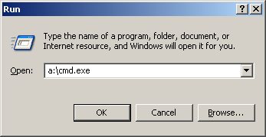
Response Toolkit: cmd.exe
Built-in command prompt should be included in the toolkit.

Slide 4
Response Toolkit
Tool Collection
  系统与时间
  已登录用户
  进程信息
  网络和端口信息

Slide 5
Response Toolkit:
Time and date
Built-in:
  date /t
  time /t
  Systeminfo.exe gives uptime with a lot of other details.
Perl:
  print localtime(time) “\n”;

Slide 6
Response Toolkit
Logged on / remotely logged on users:
  PsLoggedOn (see below)
  Netusers from Somarsoft
  Net session (native to windows)
  rasusers (see below)

Slide 7
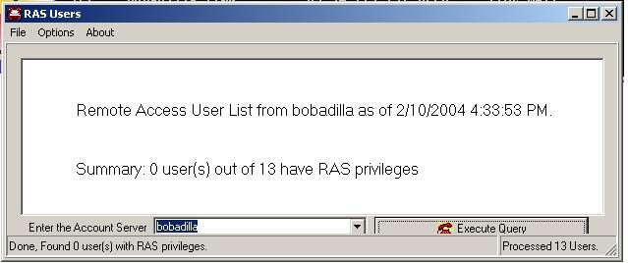
Response Toolkit
rasusers
Which users have remote access privileges on the target system.

Slide 8
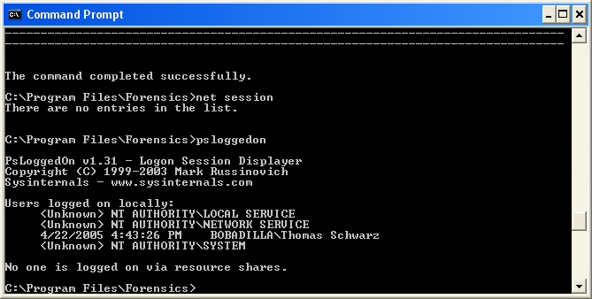
Response Toolkit
PsLoggedOn

Slide 9
Response Toolkit
Process Information

Slide 10
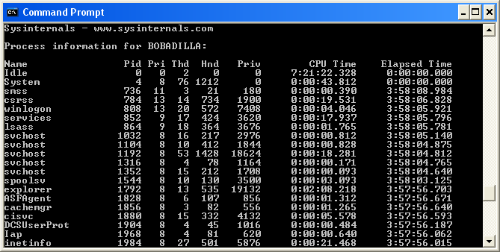
Response Toolkit
Pulist (from resource kit)
PsList

Slide 11
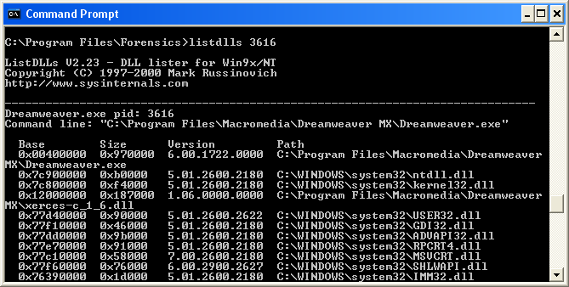
Response Toolkit
Listdlls

Slide 12
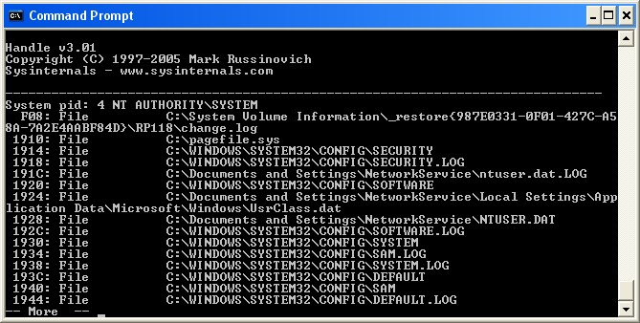
Response Toolkit
Handle gives all handles

Slide 13
Response Toolkit
Tlist is part of the Microsoft debugging tools.

Slide 14
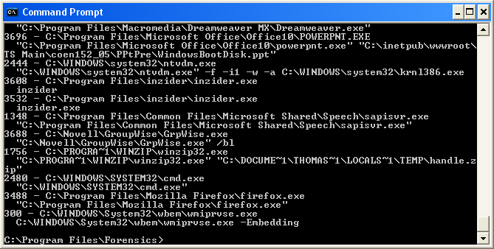
Response Toolkit
Cmdline from Diamond CS displays all processes with their arguments.

Slide 15
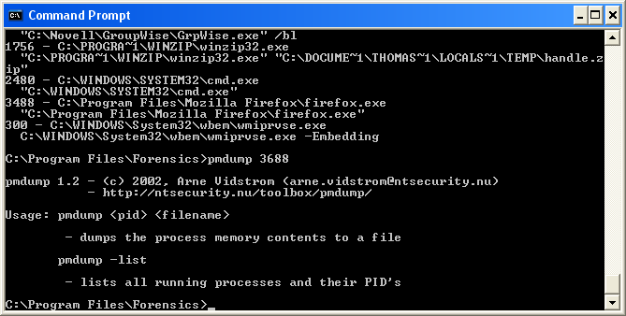
Response Toolkit
PmDump dumps memory of a process.
Notes:
Procdump: Monitors a process and writes a dump file when the process exceeds the specified CPU usage.

Slide 16
Response Toolkit
dd for windows dumps the contents of main memory into a file.

Slide 17
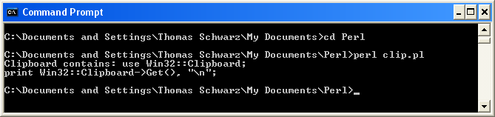
Response Toolkit
Clipboard contents can be dumped with a small perl script:
use Win32::Clipboard;
print Win32::Clipboard->Get(), "\n";

Slide 18
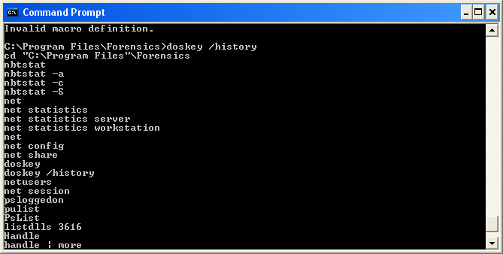
Response Toolkit
Doskey /history

Slide 19
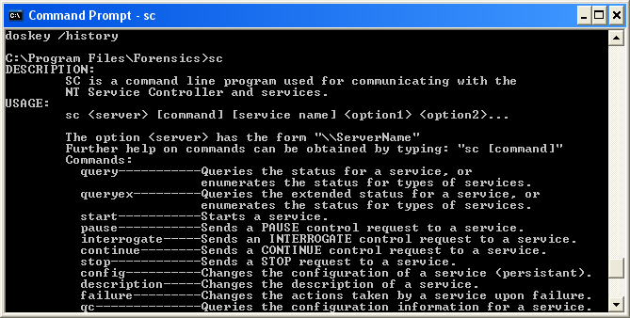
Response Toolkit
SC.exe communicates with the NT Service Controller

Slide 20
Response Toolkit
Windows has “protected storage”.
  Used to store authentication data, …
  Use PStoreView to access it.

Slide 21
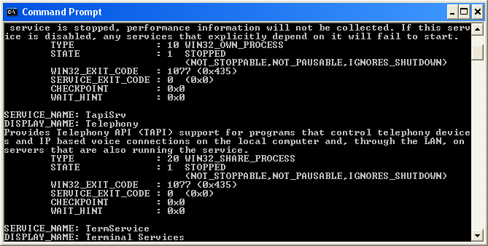
Response Toolkit
PsService views services:

Slide 22
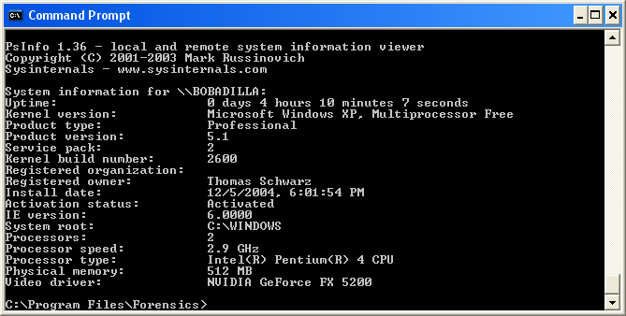
Response Toolkit
PsInfo contains interesting system data including the uptime

Slide 23
Resource Toolkit: kill
Get it from the Windows NT Resource Kit.
Terminates processes via process number.

Slide 24
Response Toolkit
Network and Port Information

Slide 25
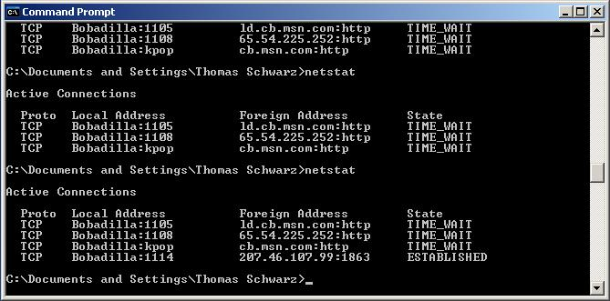
Response Toolkit
netstat
Enumerates all listening ports and all connections to those ports.

Slide 26
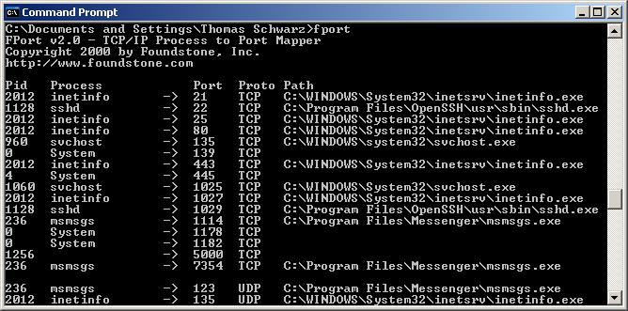
Response Toolkit
Fport
Finds open TCP/IP and UDP ports and maps them to the owning application

Slide 27
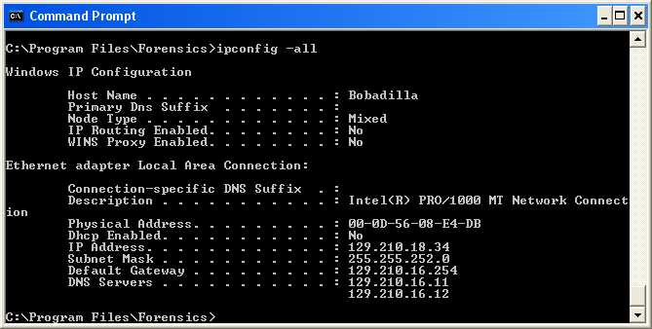
Response Toolkit
ipconfig

Slide 28
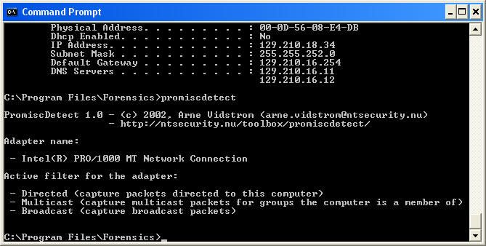
Response Toolkit
Promiscdetect
  Figures out whether network card is in promiscuous mode.

Slide 29
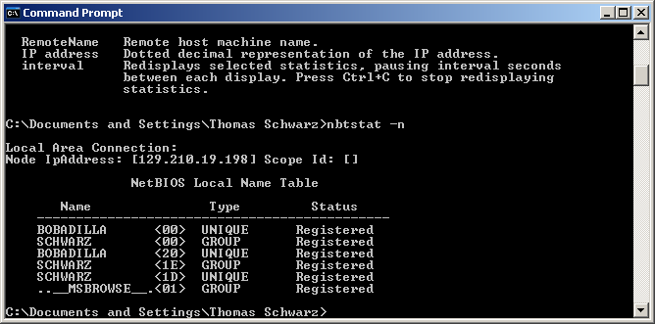
Resource Toolkit: nbtstat

Slide 30
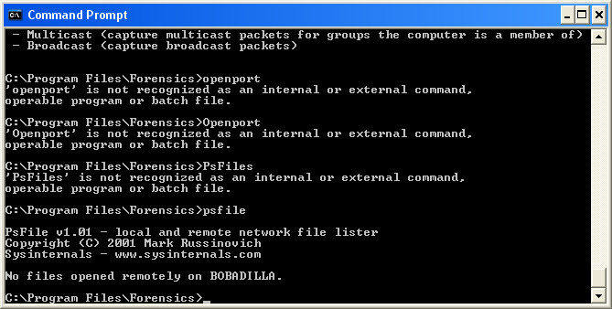
Response Toolkit
psfile

Slide 31
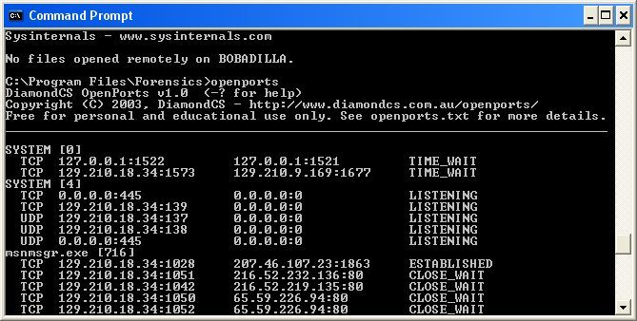
Response Toolkit
openports

Slide 32
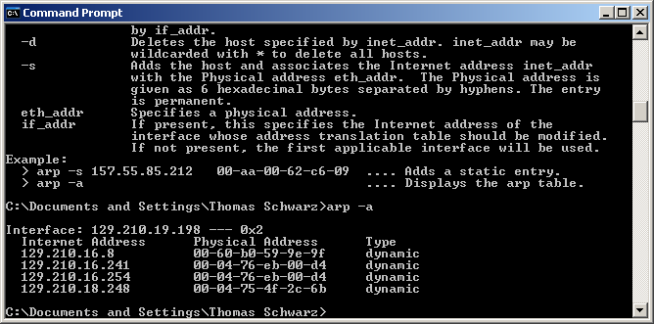
Resource Toolkit: arp

Slide 33
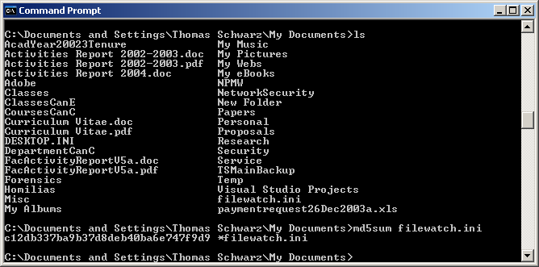
Recourse Toolkit: md5sum
Creates MD5 hashes for a file.

Slide 34
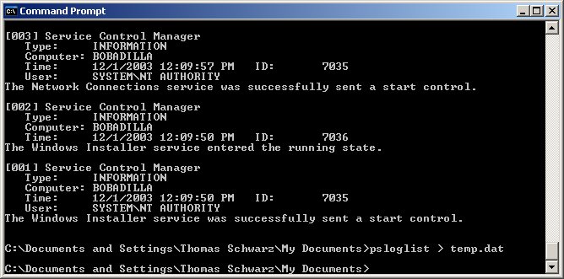
Resource Toolkit: PsLogList
Dumps the event log list.

Slide 35
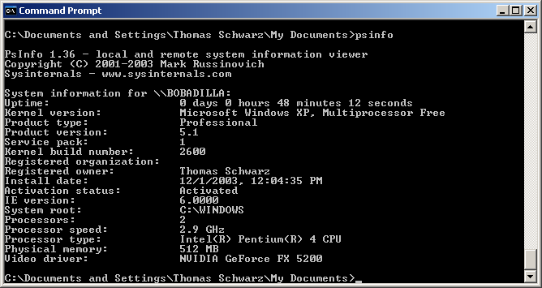
Resource Toolkit: PsInfo
Local System built.

Slide 36
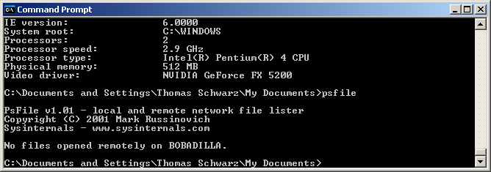
Remote Toolkit: PsFile

Slide 37
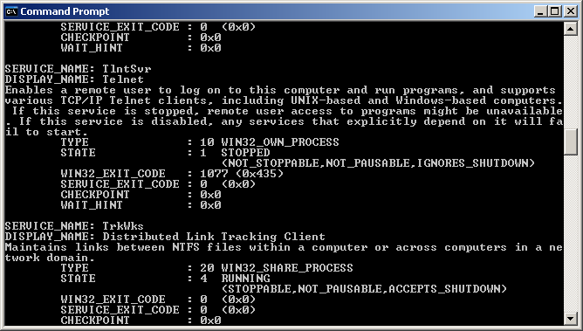
Resource Toolkit: PsService

Slide 38
Resource Toolkit
Analyzing files
  String.exe
  Bintext.exe
  Dependency Walker
  File Date Time Extractor for Windows Word
  …

Slide 39
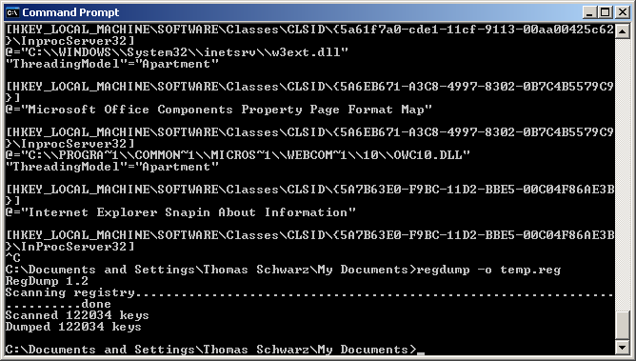
Resource Toolkit: regdump

Slide 40
Obtaining Volatile Data
Store at least
System date and time.
List of current users.
List of current processes.
List of currently open sockets.
Applications listed on open socket.
List of systems with current or recent connections to the system.

Slide 41
Obtaining Volatile Data: Procedure
Execute a trusted cmd.exe
Record system time and date.
Determine who is logged on.
Record file MAC.
Determine open ports.
List all apps associated with open ports.

Slide 42
Obtaining Volatile Data: Procedure
列出所有正在运行的进程。
列出当前和最近的连接。
记录系统时间和日期。
记录初始响应期间使用的命令。

Slide 43
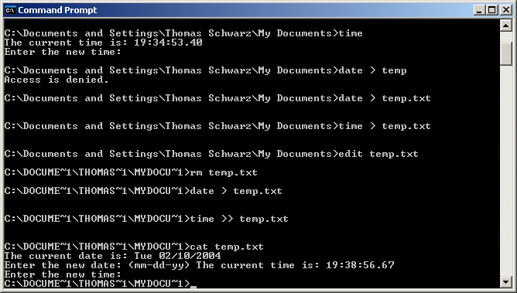
Recording System Time

Slide 44
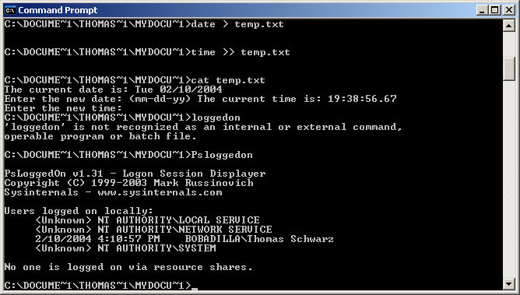
Determining Logons

Slide 45
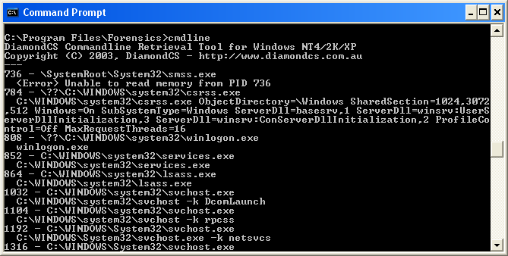
Determining Logons
Cmdline from DiamondCS

Slide 46
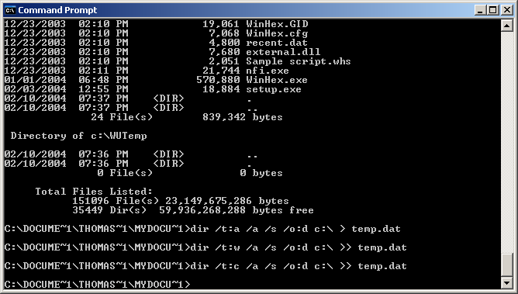
Determining File MAC

Slide 47
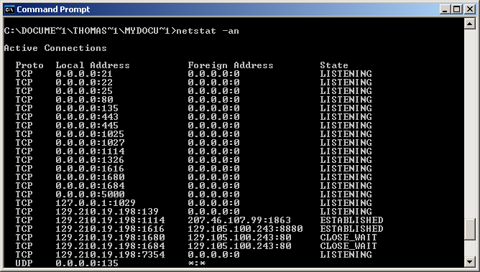
Determining Open Ports

Slide 48
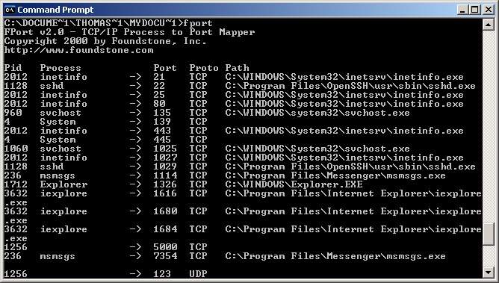
Listing Applications with Open Ports

Slide 49
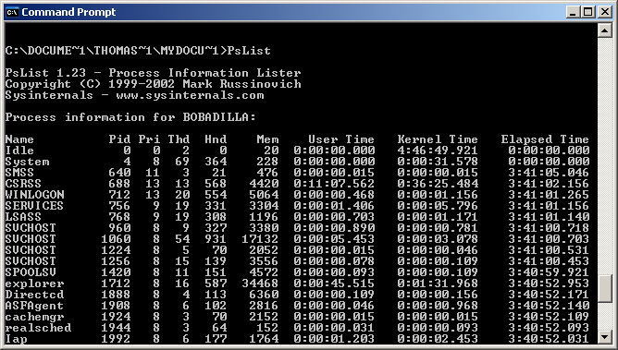
Listing all running processes

Slide 50
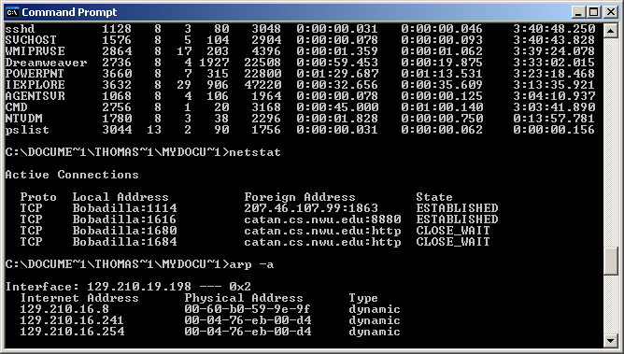
List current connections

Slide 51
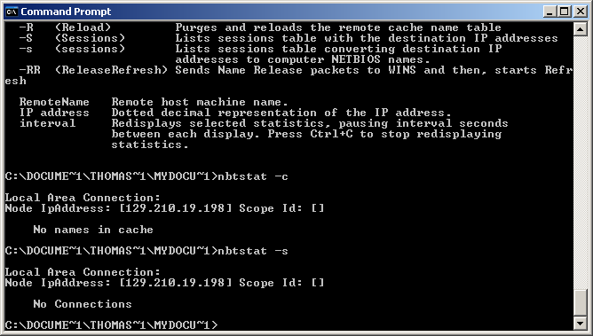
List current connections

Slide 52
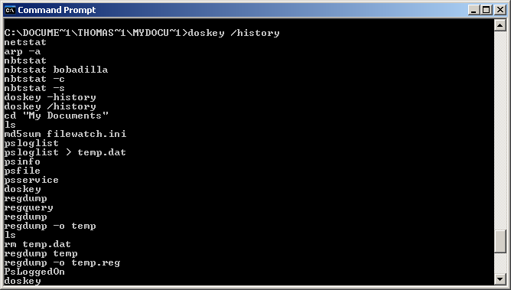
Documenting history

Slide 53
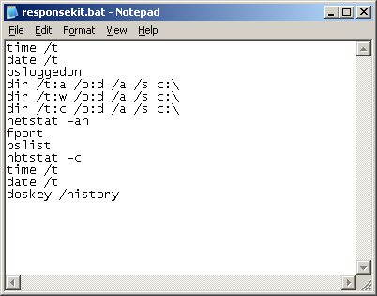
Scripting the response

Slide 54
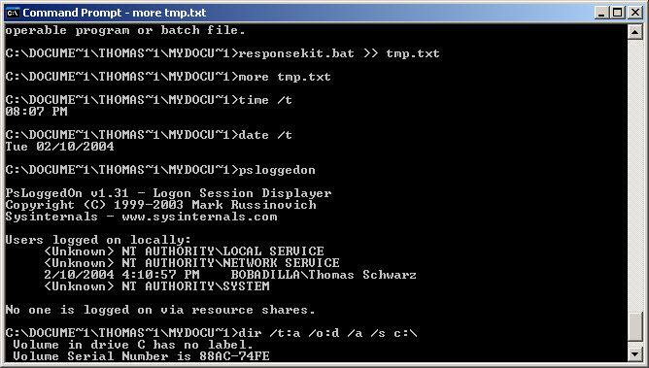
Scripting the response

Slide 55
执行受信任的 cmd.exe
记录系统时间和日期。
确定谁登录。
记录文件 MAC。
确定开放端口。
列出与开放端口关联的所有应用。

Slide 56
List of MS-DOS commands
dir查看当前所在目录的文件和文件夹
cd 目录名：进入特定的目录
  cd\ 退回到根目录
  cd..退回到上一级目录
md 目录名：建立文件夹
rd 目录名：删除文件夹

Slide 57
List of MS-DOS commands
copy 路径\文件名 路径\文件名
move 路径\文件名 路径\文件名
del 文件名：删除
  del *.*：删除当前文件夹下所有文件
  del不能删除文件夹
Deltree 删除文件夹和它下面的所有子文件夹

